Slide 1
Ta-feng Dataset Analysis

Slide 2
Contents
Introduction
Overview of the Datasets
Promising Utilisations
State-of-the-Art Works
Two Draft Models for Retailer
Discussion

Slide 3
Introduction
Ta-Feng is a grocery shopping dataset released by ACM RecSys, it covers products from food, office supplies to furniture.
The dataset collected users` transaction data of 4 months, from November 2000 to February 2001.
The total count of transactions in this dataset is 817741, which belong to 32266 users and 23812 products.
Store located in Taipei.
3

Slide 4
Overview: Data Quality
Evaluation of Data Quality
No NULL in the table
Since the grocery shop knows the product information, the unreliable data usually appears in customer side.
For example:
One customer ID who purchased a lot may be an ID which is used to identify unknown customer.
Customers with other age information may be assigned “J” (>65) as their ages.
Too many “H” (Unknown Distance).
If one customer has multiple transactions on one day, this table cannot indicate this situation.
One product may belong to multiple subclass.
4

Slide 5
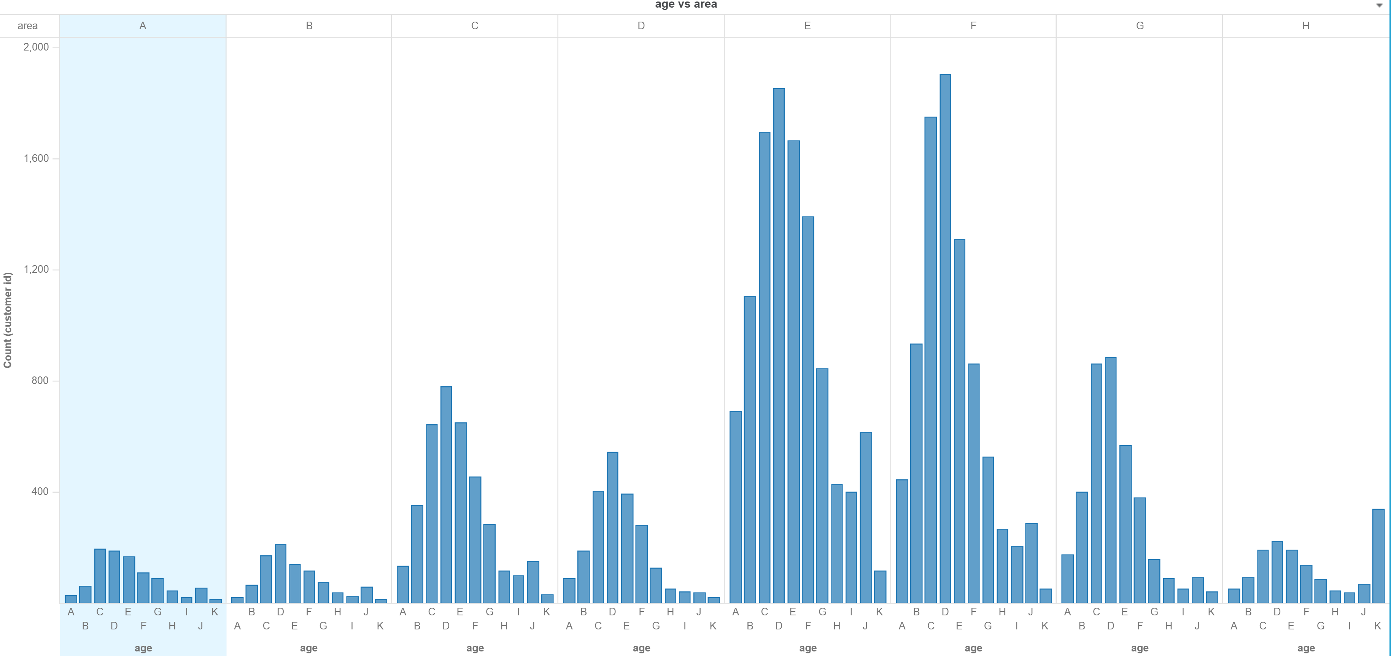
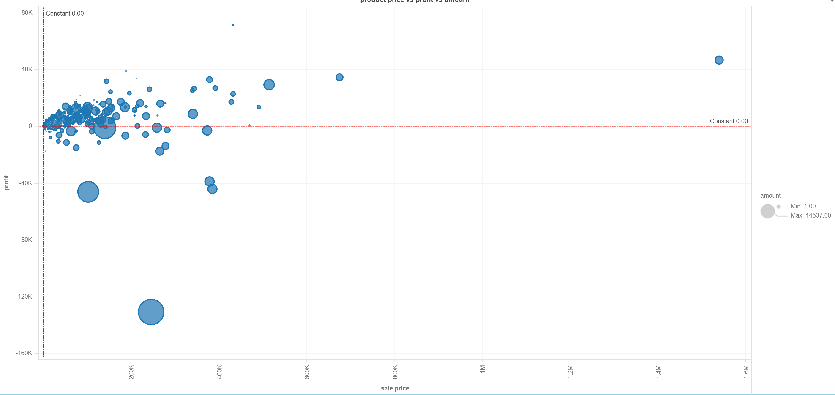
Overview: Descriptive Analysis
5

Slide 6
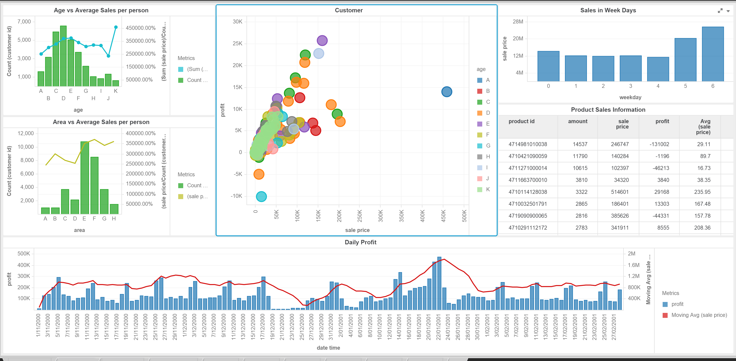
Overview: Descriptive Analysis
6

Slide 7
Overview: Descriptive Analysis
Top 10 Recorder Products
4714981010038
4711080010112
4711271000014
4710094097768
4710105015118
4710011401128
4710114128038
4710018004605
4719090900065
4710088433312
Products with Top 5 Frequency in different areas and age groups
Top 5 Product | A | B | C | D | E | F | G | H
1 | 4714981010038 | 4714981010038 | 4711271000014 | 4714981010038 | 4714981010038 | 4714981010038 | 4714981010038 | 4714981010038
2 | 4711271000014 | 4711271000014 | 4714981010038 | 4711271000014 | 4711271000014 | 4711271000014 | 4711271000014 | 4711271000014
3 | 4719090900065 | 4710114128038 | 4710114128038 | 4710114128038 | 4719090900065 | 4719090900065 | 4711080010112 | 4711080010112
4 | 4710054380619 | 4713985863121 | 4719090900065 | 4710291112172 | 4711080010112 | 4711080010112 | 4710114128038 | 4713985863121
5 | 4710291112172 | 4719090900065 | 4710421090059 | 4719090900065 | 4710265849066 | 4710114128038 | 4710421090059 | 4710011401128
Top 5 Product | A | B | C | D | E | F | G | H | I | J | K
1 | 4714981010038 | 4714981010038 | 4714981010038 | 4714981010038 | 4714981010038 | 4714981010038 | 4714981010038 | 4714981010038 | 4714981010038 | 4714981010038 | 4714981010038
2 | 4711271000014 | 4711271000014 | 4711271000014 | 4711271000014 | 4711271000014 | 4711271000014 | 4711271000014 | 4711271000014 | 4711271000014 | 4711271000014 | 4711271000014
3 | 4711080010112 | 4711080010112 | 4710088410610 | 4711080010112 | 4710114128038 | 4719090900065 | 4719090900065 | 4719090900065 | 4719090900065 | 4710265849066 | 4713985863121
4 | 4710088433312 | 4710032501791 | 4710054380619 | 4710088410610 | 4719090900065 | 4710114128038 | 4710114128038 | 4710583996008 | 4710265849066 | 4719090900065 | 4710011401128
5 | 4710421090059 | 4710088410610 | 4710088410139 | 4710114128038 | 4713985863121 | 4713985863121 | 4710583996008 | 4711080010112 | 4710583996008 | 4710583996008 | 4711080010112
7

Slide 8
Promising Utilisations
Retailer:
(1) Association rule, if two things appear together, we can make them far from each other or closer to each other;
(2) Recommendation system for weekly product advertisement;
(3) New product: automated basket filling for online grocery shopping.
(4) Customer segmentations
(5) Price elasticity and discount evaluation
Consumer:
When will the price decrease on certain items? (However, consumers usually don’t have historical price information.)
Wholesaler:
Supply and demand balance. When should the wholesale price increase? (not my personal interests, and can be solved by universal approaches, time series prediction.)
8
Notes:
, decrease False positive is more important than decreasing false negative in my view.

Slide 9
Two Draft Models for Retailers
I believe there are two groups of customers:
(1) customers who dislike wasting time on grocery shopping, (like me, usually do it online)
(2) customers who enjoy searching goods in supermarkets.
Each group needs a product to meet their lifestyles.
“Automated basket filler” helps the grocery shopping haters quickly fill the online shopping cart with the items they frequently purchased.
“Personalised newsletter” helps the grocery shopping lovers explore other items they may like.
9
Notes:
, decrease False positive is more important than decreasing false negative in my view.

Slide 10
State-of-the-art works
Retailer:
Recommendation system:
Sato, M., Izumo, H. and Sonoda, T., 2016. Model of Personal Discount Sensitivity in
Recommender Systems. IxD&A, 28, pp.110-123.
Next basket prediction:
Rendle, S., Freudenthaler, C. and Schmidt-Thieme, L., 2010, April. Factorizing personalized markov chains for next-basket recommendation. In Proceedings of the 19th international conference on World wide web (pp. 811-820). ACM.
Yu, F., Liu, Q., Wu, S., Wang, L. and Tan, T., 2016, July. A dynamic recurrent model for next basket recommendation. In Proceedings of the 39th International ACM SIGIR conference on Research and Development in Information Retrieval (pp. 729-732). ACM.
Customer segmentations
https://www.slideshare.net/jonsedar/customer-clustering-for-marketing
10
Notes:
, decrease False positive is more important than decreasing false negative in my view.

Slide 11
Next Basket Prediction
Simplify the problem and find a quick workable solution:
I try to predict which items that a consumer bought in the previous two transactions will appear in the current transaction.
The last transaction of each consumer form the testing set, the other transactions form the training set.
Remove consumers who made less than 4 transactions and do not make any reorder in the training set.
5235 out of 32266 consumers are left.
Very imbalanced dataset. Only 5.4% products in the previous two transactions have been reordered in the current transactions.
11
Notes:
, decrease False positive is more important than decreasing false negative in my view.

Slide 12
Next Basket Prediction
Feature preparation:
For each product bought in the previous transaction:
Bought amount in the previous transaction
Bought amount in the transaction before the previous transaction
Time difference between current transaction and the last one in days
Time difference between current transaction and the transaction before the last one
Price difference…
Customers’ location and age information
….
One Hot encoding for categorical feature
For categorical features that have too many categories, such as the product ID and subclass, I use word2Vec to represent them as 20*1 vectors (since I plan to use XGBoost, the feature dimension cannot be too large).
12
Notes:
, decrease False positive is more important than decreasing false negative in my view.

Slide 13
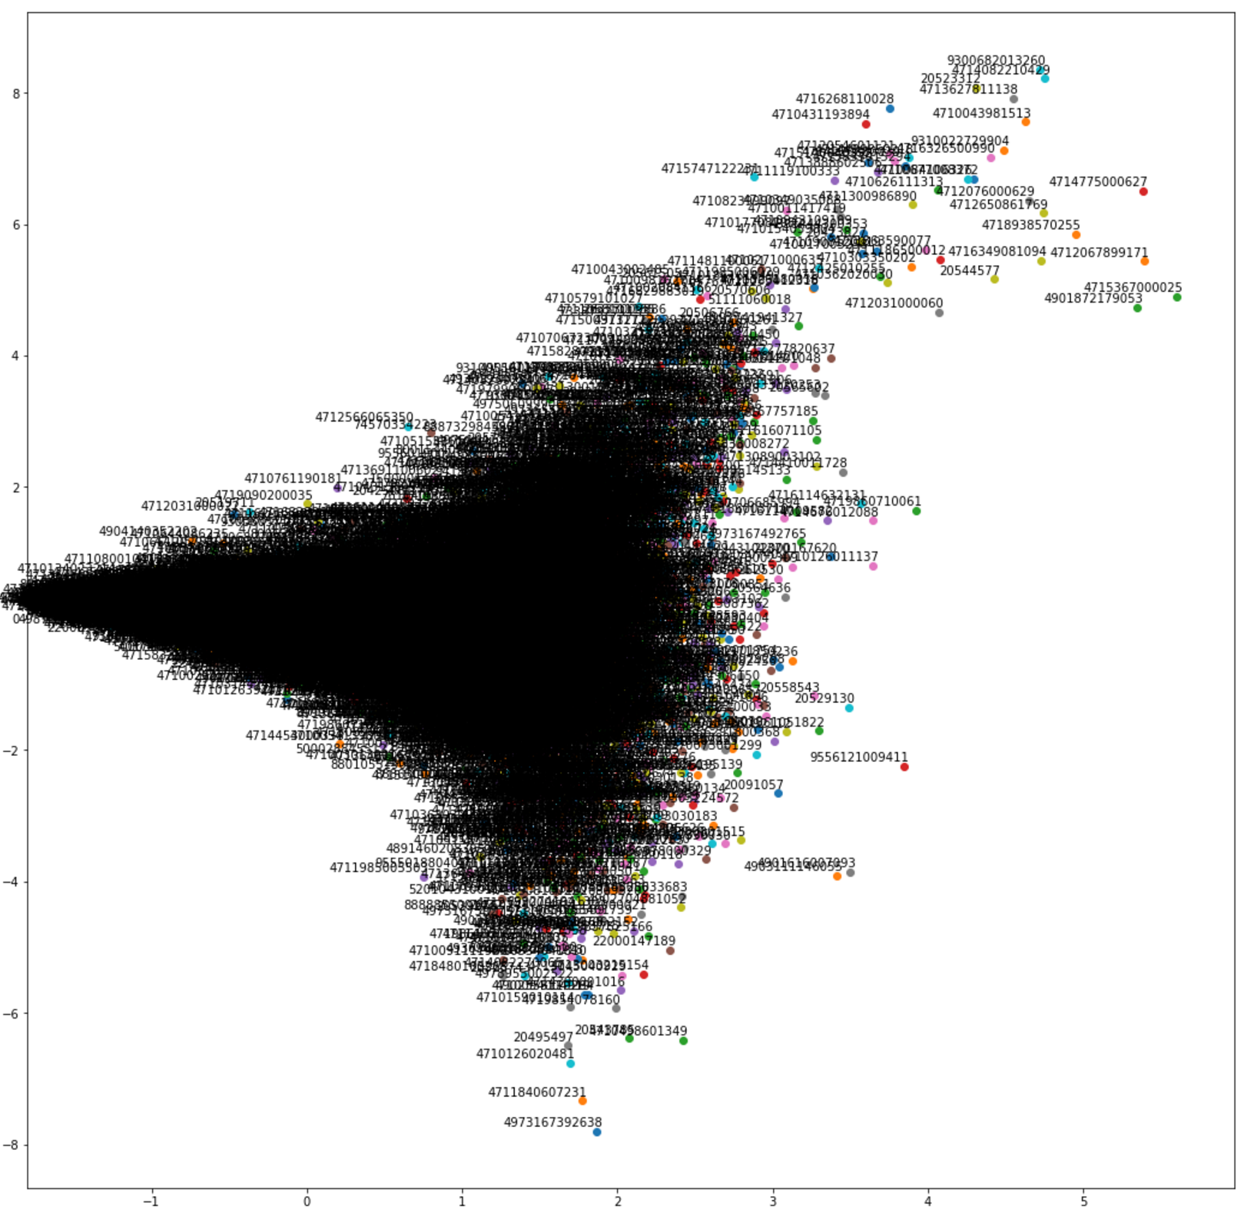
Next Basket Prediction
.
Visualise Word2Vec
representation of Product ID
13
Notes:
, decrease False positive is more important than decreasing false negative in my view.

Slide 14
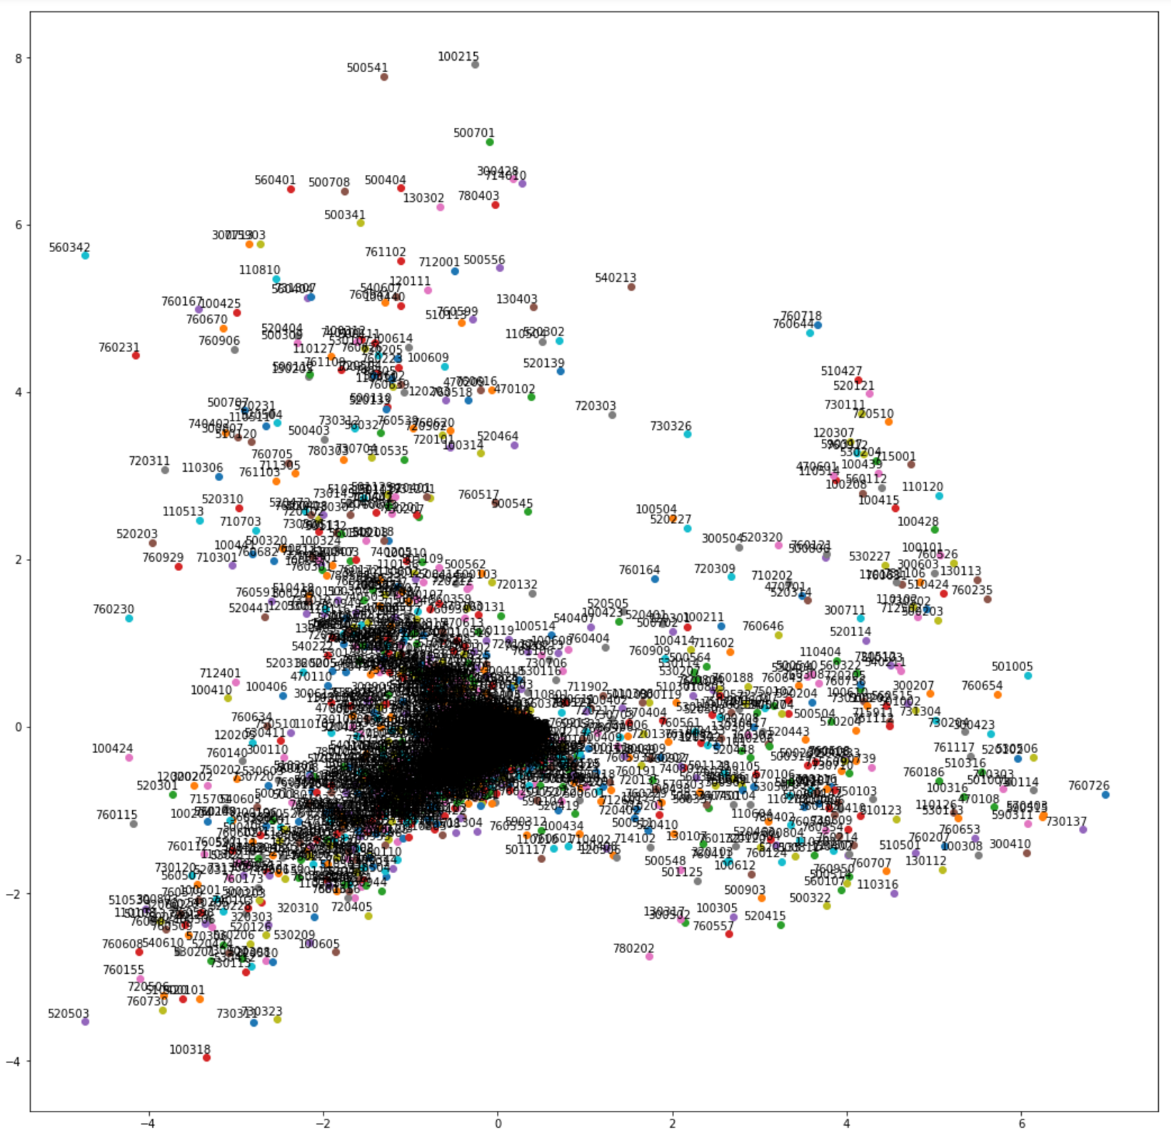
Next Basket Prediction
.
Visualise Word2Vec
representation of Subclass
14
Notes:
, decrease False positive is more important than decreasing false negative in my view.

Slide 15
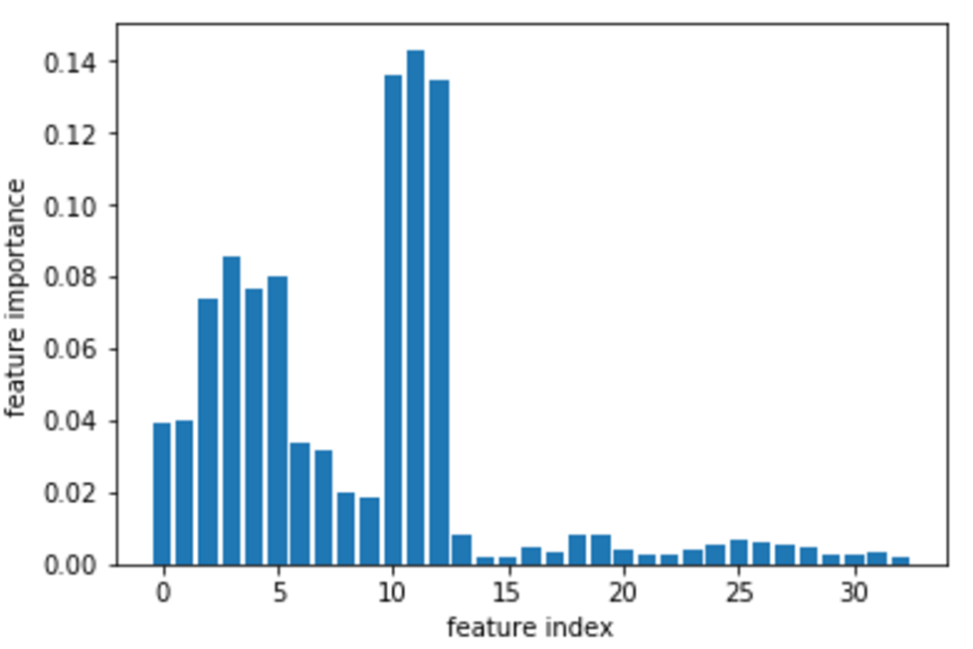
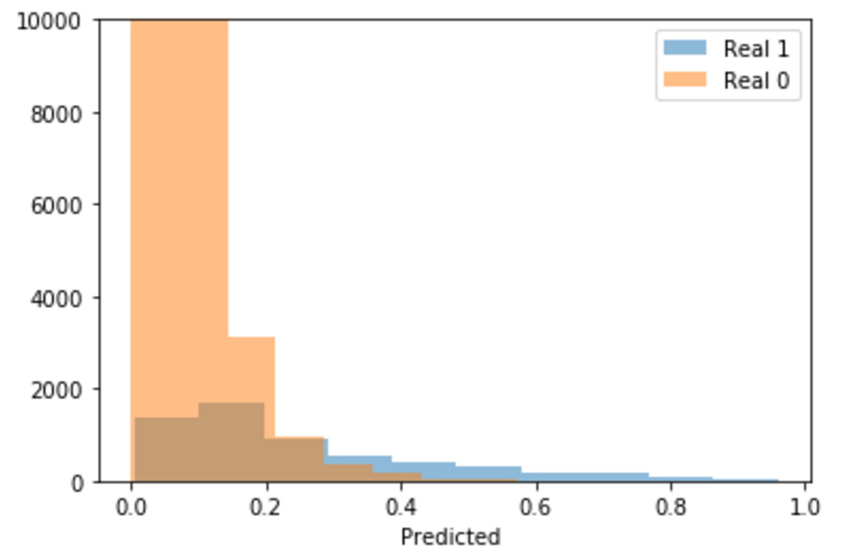
Next Basket Prediction
Feature Importance Prediction Results
Confusion matrix
index | name
0 | last_weekday',
1 | 'last_weekday_2',
2 | 'diff_last_day',
3 | 'diff_last_day_2',
4 | 'last_price',
5 | 'last_price_2',
6 | 'last_amount',
7 | 'last_amount_2',
8 | 'last_month',
9 | 'last_month_2',
10 | 'subcls',
11 | 'prod_id',
12 | cust_id'
 | Predict 0 | Predict 1
Real 0 | 75045 | 2580
Real 1 | 2807 | 2877
Recall: 0.506,
Precision: 0.527,
Accuracy: 0.935,
F1 score: 0.516
15
Notes:
, decrease False positive is more important than decreasing false negative in my view.

Slide 16
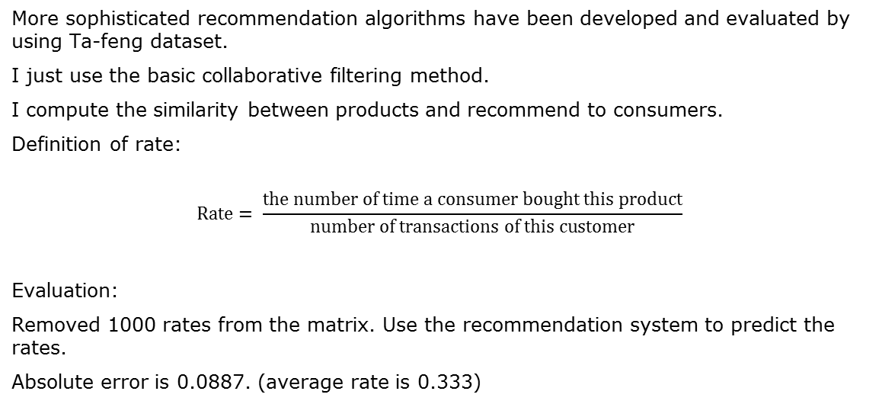
Recommendation System
More sophisticated recommendation algorithms have been developed and evaluated by using Ta-feng dataset.
I just use the basic collaborative filtering method.
I compute the similarity between products and recommend to consumers.
Definition of rate:
$$Rate= \frac{\text{the} \text{number} \text{of} \text{time} \text{a} \text{consumer} \text{bought} \text{this} \text{product}}{\text{number} \text{of} \text{transactions} \text{of} \text{this} \text{customer}}$$
Evaluation:
Removed 1000 rates from the matrix. Use the recommendation system to predict the rates.
Absolute error is 0.0887. (average rate is 0.333)
16
Notes:
Matrix is too sparse, when I try to use SVD to decrease the dimension, all the eigenvalues are similar small. I need to use almost 90% eigenvalues to capture the 90% original information.

Slide 17
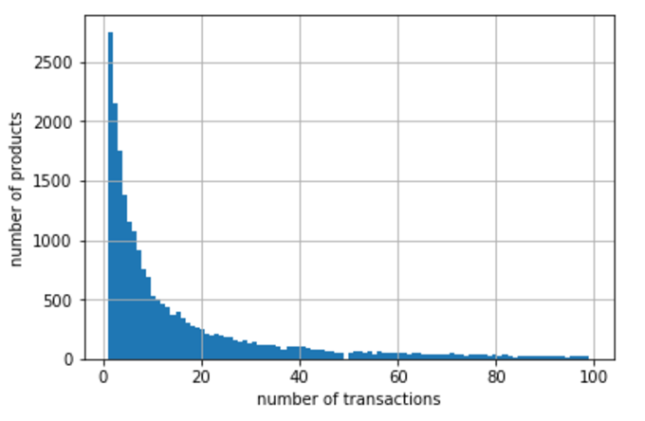
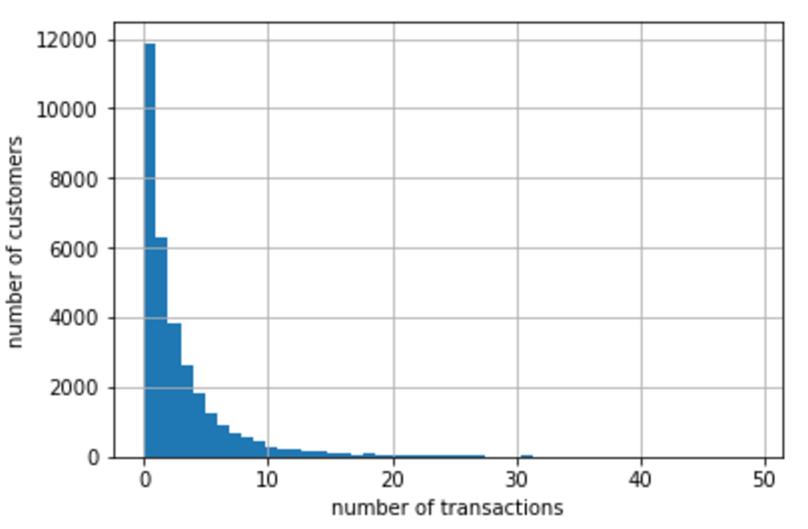
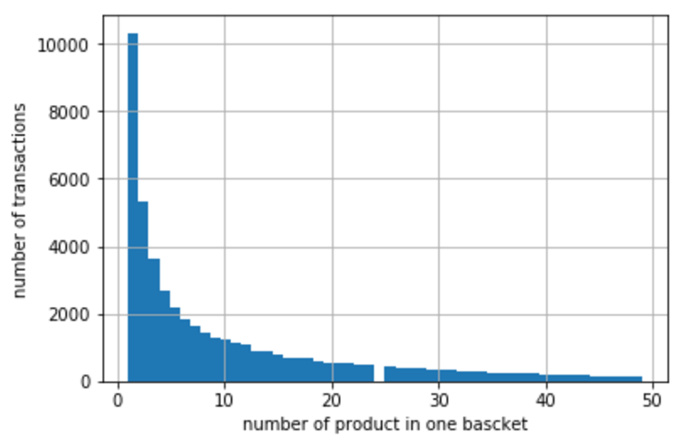
Association Rule
Association Rule on Products
Support level 0.005
{'4710011401128', '4710011401135'},
{'4710011401128', '4710011405133'},
{'4711271000014', '4714981010038'}.
Confidence level 0.3
{‘4710011401128’} --> {‘4710011401135’}， conf: 0.42761148442272445
{‘4710011401135’} --> {‘4710011401128’}， conf: 0.7526881720430108
{‘4710011405133’} --> {‘4710011401128’}， conf: 0.6595744680851064
{‘4710011401128’} --> {‘4710011405133’}， conf: 0.37874160048869887
Distribution of product
vs. number of transactions
Distribution of customer
vs. number of transactions
Distribution of transactions
vs. different basket sizes
17
Notes:
, decrease False positive is more important than decreasing false negative in my view.

Slide 18
Association Rule
Association Rule on Subclass
Support level > 0.01
{100102, 100205},
{100205, 100505},
{100205, 110411},
{130204, 130315},
…
32 pairs
Confidence level > 0.3
{100312} --> {100205}， conf: 0.44585236481508767
{530103} --> {530101}， conf: 0.4327076041998091
{500203} --> {500201}， conf: 0.3620643069440692
{100201} --> {100205}， conf: 0.3576039633688635
{560402} --> {560201}， conf: 0.3194888178913738
{100323} --> {100205}， conf: 0.3698943159097401
18
Notes:
, decrease False positive is more important than decreasing false negative in my view.

Slide 19
Conclusion and Discussion
Very interesting dataset capturing the transactions in the special time period
Need more data to split this table to small ones
More time to make something really useful
19
Notes:
, decrease False positive is more important than decreasing false negative in my view.

